Slide 1

AWS IAM Configuration with Terraform
Automating IAM Roles, Policies, Group and Users

Slide 2
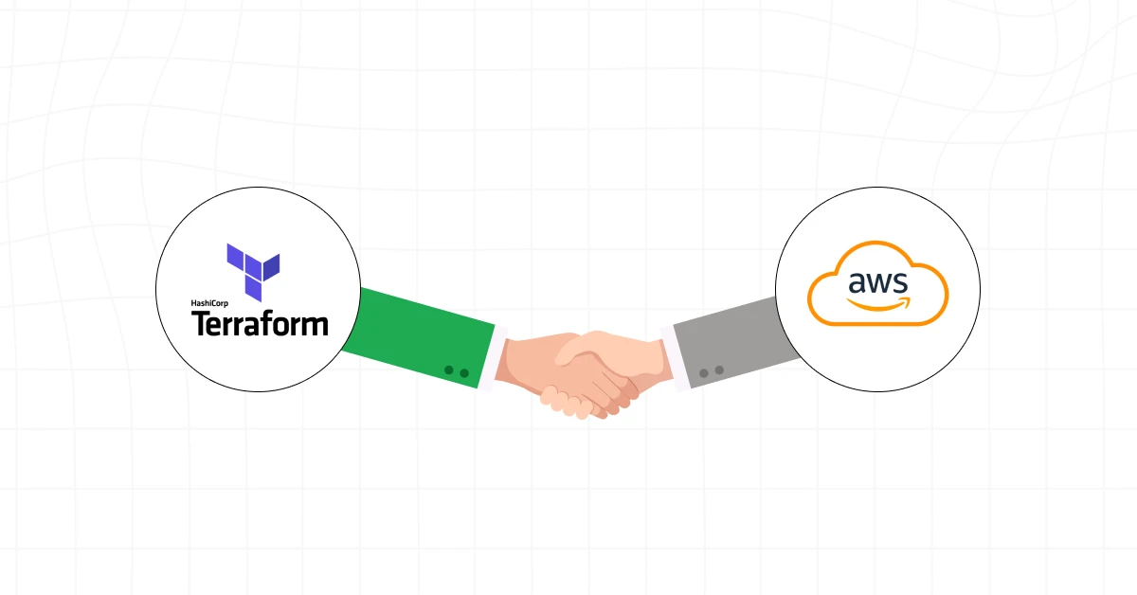
Objective
Automate the creation of IAM groups, users, and policies using Terraform.
AWS Identity and Access Management (IAM) is a powerful service that enables you to manage access to your AWS resources. With IAM, you can create and manage IAM users, groups, roles, and policies to grant or deny access to specific resources or actions.
Terraform, a popular infrastructure as a code tool, can deploy IAM resources in a reliable, consistent, and repeatable manner. This article will explore how to use Terraform to create and manage IAM users, groups, and policies in AWS. We will cover the basics of IAM, the benefits of using Terraform for IAM deployments, and provide step-by-step instructions for deploying IAM resources using Terraform. By the end of this article, you will have a solid understanding of using Terraform to deploy IAM resources and streamline your AWS infrastructure management.

Slide 3
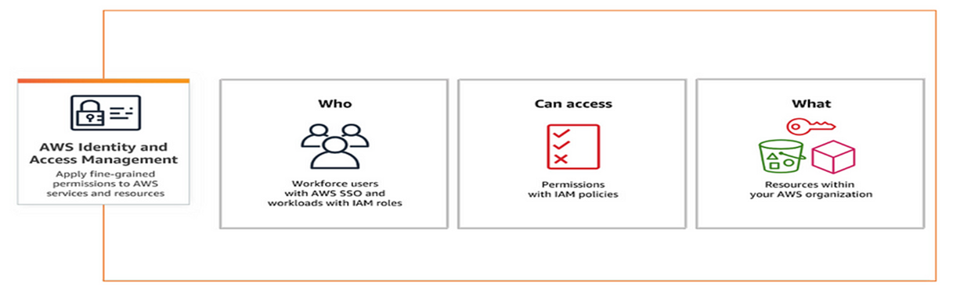
Objective:
AWS IAM: AWS users are individual identities that can be created and managed within an AWS account. Each user is assigned a set of security credentials, including a username and password, or access keys, which are used to authenticate and authorize access to AWS resources.
AWS user group: AWS user groups are collections of users that share common permissions and access to AWS resources. By assigning permissions to a group rather than to individual users, you can simplify the management of access to resources.
AWS Role: AWS roles are a way to delegate access to AWS resources. Rather than assigning permissions to individual users, you can create a role and define a set of permissions that the role can assume. This allows you to grant permissions to applications, services, or other AWS accounts, without the need to share long-term access keys.
AWS User Policy: AWS policies are documents that define permissions and access levels for AWS resources. They can be attached to users, groups, or roles and define which actions can be performed on which resources. Policies are written in a JSON format and can be customized to meet the specific needs of your organization.

Slide 4

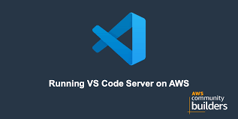
Prerequisites:
Install Terraform CLI
Install AWS CLI
AWS Account
Code Editor (I used VS Code for this deployment)

Slide 5
IAM Groups and Policies
Create IAM users and groups, and align IAM users as part of this Groups.
Deployment Process
Creating an IAM User: In this task, we used Terraform to create a new IAM users named “ashvitha” “shivaprasadh” “srinivas”. We also generated access and secret keys for the user and downloaded them.
Creating an IAM Group: In this task, we used Terraform to create a new IAM groups named “Group-1” and “Group-2”. We then added the “ashvitha” and “shivaprasadh” users to the Group-1 and create another IAM group named Group-2, We add user “srinivas”.
Attaching an AWS Managed Policy: In this task, we used Terraform to attach an AWS managed policy (in this case, the “AmazonS3FullAccess” policy) to the Group-1.
Creating a Custom IAM Policy: In this task, we used Terraform to create a custom IAM policy that allows user in the “Group-2” group to ListAllMyBuckets. We then attached this policy to the group.

Slide 6
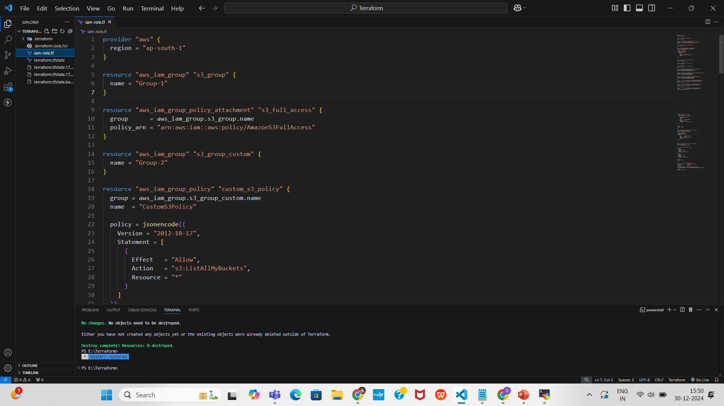

AWS Provider Configuration and S3 Group Setup
Create provider
The provider in Terraform is a configuration file that specifies the cloud provider and its corresponding plugin that Terraform will use to manage resources in that provider. In this case my region is “ap-south-1”.
This Terraform configuration creates an IAM group named Group-1 and attaches the AmazonS3FullAccess managed policy to it. The aws_iam_group resource defines the group, while the aws_iam_group_policy_attachment resource links the group to the specified managed policy using its ARN. This setup grants all users in Group-1 full access to Amazon S3 services, enabling them to perform actions like creating, reading, updating, and deleting S3 buckets and objects. Using managed policies ensures consistency and simplifies permission management.

Slide 7
Custom Policy:
Here I attached AWS custom policy (S3:ListAllMyBuckets) to Group-2
The policy is linked to the Group-2 IAM group using the group attribute.
This policy is limited to listing buckets only; no read/write permissions are included. Useful for users who need to view the list of s3 buckets without accessing bucket contents.

Slide 8
IAM User Creation and Group Membership Assignment
This Terraform configuration defines the creation of three IAM users (shivaprasadh, ashvitha, and srinivas) and assigns them to specific IAM groups to manage permissions effectively. The aws_iam_user resources create individual users, each with a unique name.
The aws_iam_user_group_membership resources then associate these users with appropriate IAM groups.
shivaprasadh and ashvitha are both assigned to the IAM group s3_group through separate aws_iam_user_group_membership resources. This group membership enables these users to inherit all permissions defined for the s3_group.
srinivas is assigned to a different IAM group, s3_group_custom, using a separate aws_iam_user_group_membership resource, thereby granting permissions specific to that group.
This structure promotes efficient access control by grouping users with similar roles and responsibilities under a common IAM group, simplifying the management of permissions. The configuration ensures that users are provided only with the permissions they need based on their assigned group policies.

Slide 9
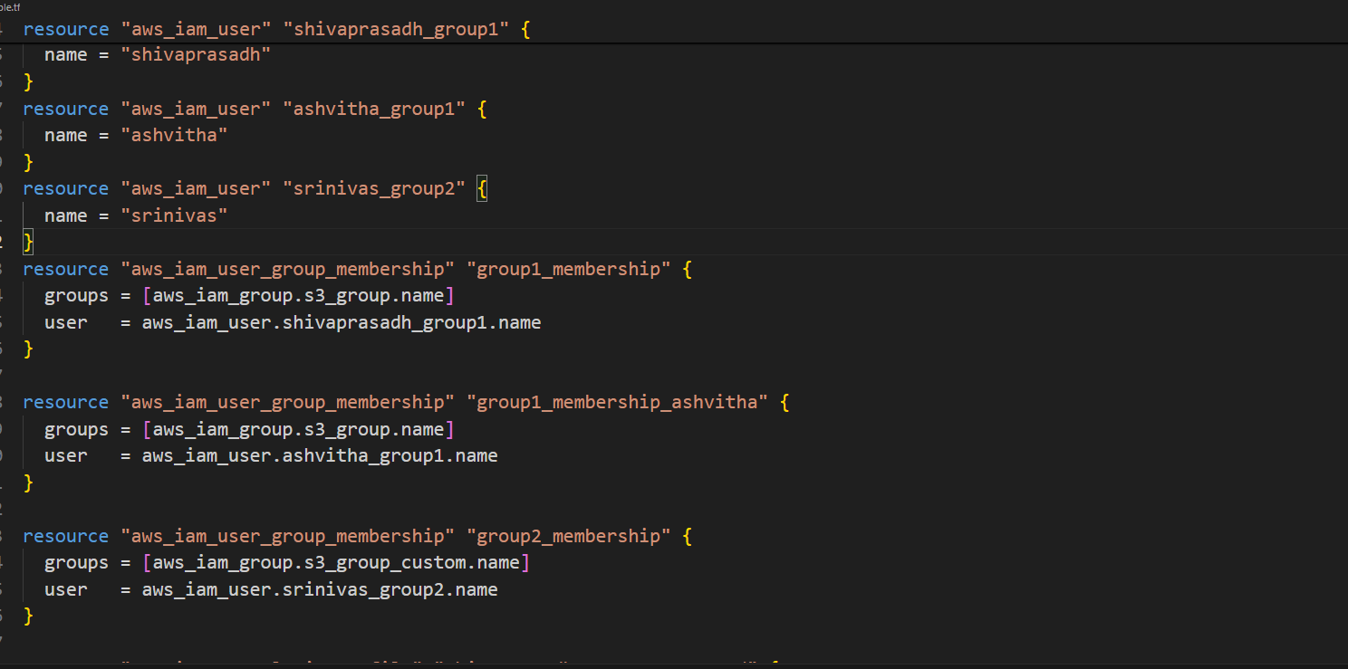
Group Membership Assignment for IAM Users
This Terraform configuration showcases the creation of three IAM users (shivaprasadh, ashvitha, and srinivas) and their assignment to specific IAM groups. Each user inherits permissions defined by the policies of their respective groups. This approach simplifies access management by organizing users with similar roles into shared permission sets.

Slide 10
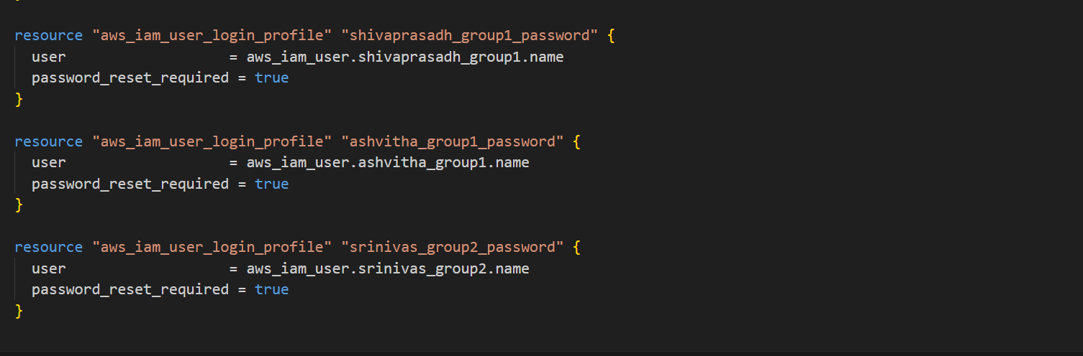
IAM User Login Profile Configuration
This Terraform configuration sets up login profiles for the three IAM users (shivaprasadh, ashvitha, and srinivas). Each aws_iam_user_login_profile resource creates a login profile for its respective user, enabling them to access the AWS Management Console using a password. The password_reset_required attribute is set to true for all users, ensuring that they must reset their password upon first login. This approach enhances security by enforcing a personalized password setup for each user.

Slide 11
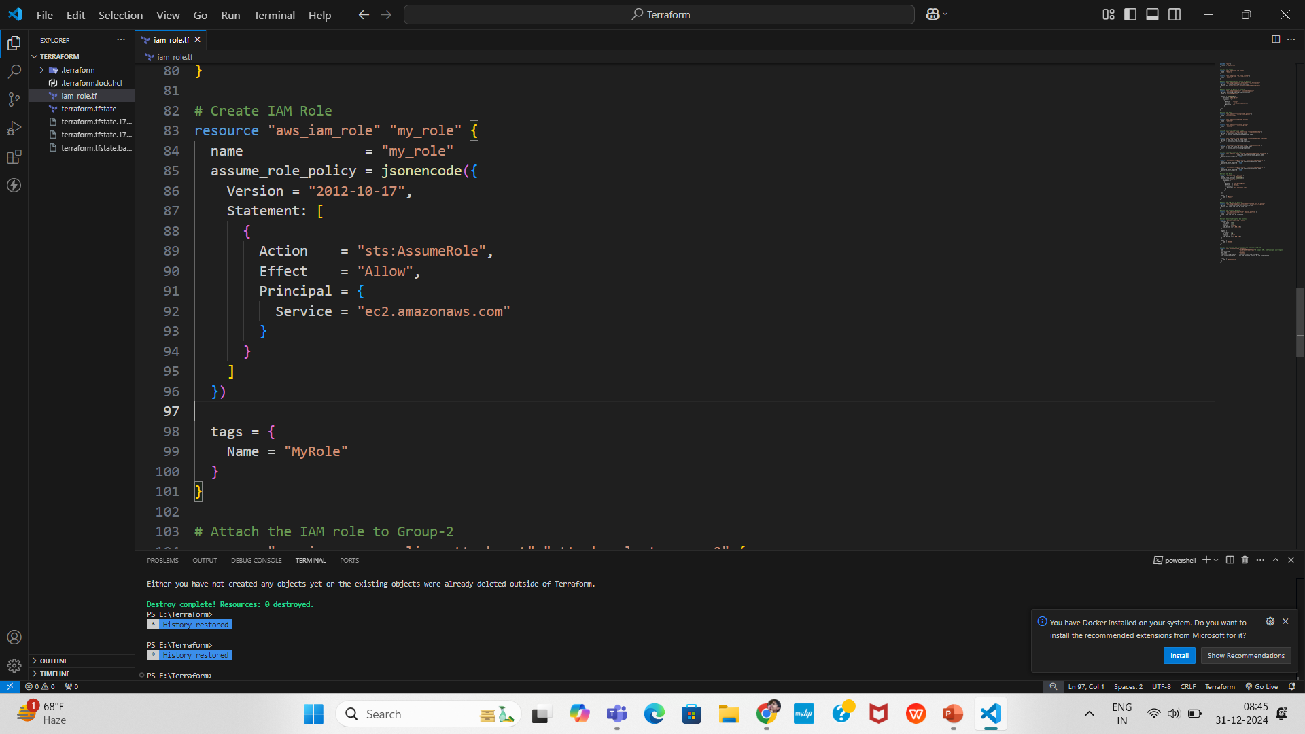
EC2 Instance Configuration with IAM Role
This Terraform configuration defines an IAM role, attaches it to an IAM group, and creates an EC2 instance with specific permissions and security settings.
IAM Role (my_role): This role is created to allow EC2 instances to assume it, as defined by the sts:AssumeRole policy. The role is granted to EC2 instances via the ec2.amazonaws.com service, enabling them to perform actions defined by attached policies.

Slide 12
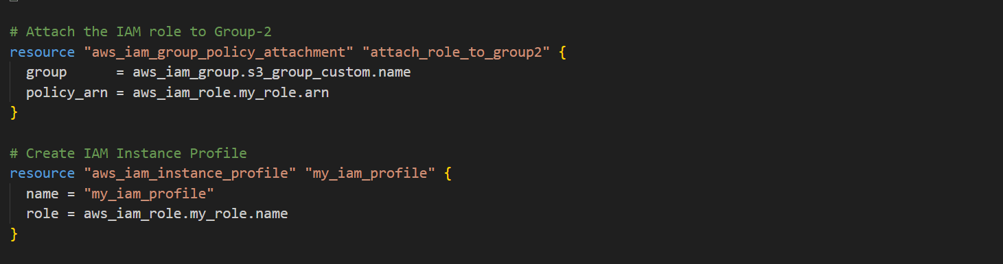
Configuration with IAM Role, Instance Profile
IAM Group Policy Attachment: The my_role IAM role is attached to Group-2 (s3_group_custom), ensuring that members of this group can assume the role and utilize the permissions defined within it. This allows the group to manage EC2 instances or other resources associated with the role.
IAM Group Policy Attachment: The my_role IAM role is attached to Group-2 (s3_group_custom), ensuring that members of this group can assume the role and utilize the permissions defined within it. This allows the group to manage EC2 instances or other resources associated with the role.

Slide 13
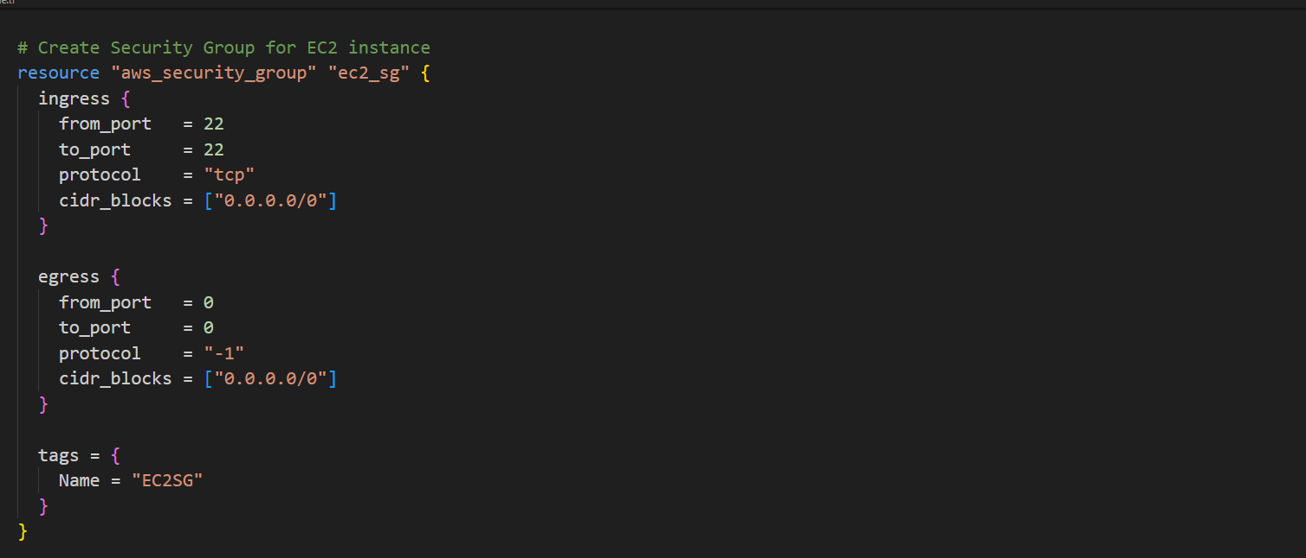
Security Group Configuration
Security Group (ec2_sg): A security group is created for the EC2 instance that allows inbound SSH access on port 22 from any IP address (0.0.0.0/0), along with unrestricted outbound traffic.

Slide 14
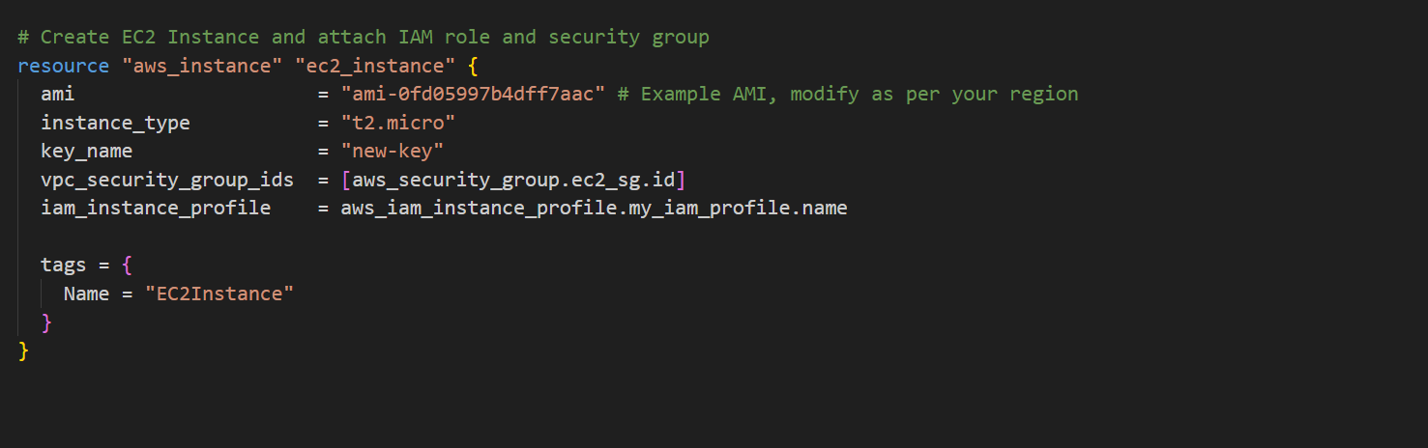
Instance Configuration
EC2 Instance: An EC2 instance (ec2_instance) is launched using a specified Amazon Machine Image (AMI). The instance is configured with a security group for network traffic control and an IAM instance profile that grants it the permissions specified in the my_role IAM role.
This configuration allows for secure EC2 instance management, ensuring proper role-based access control (RBAC) and network security through the use of IAM roles, instance profiles, and security groups.

Slide 15
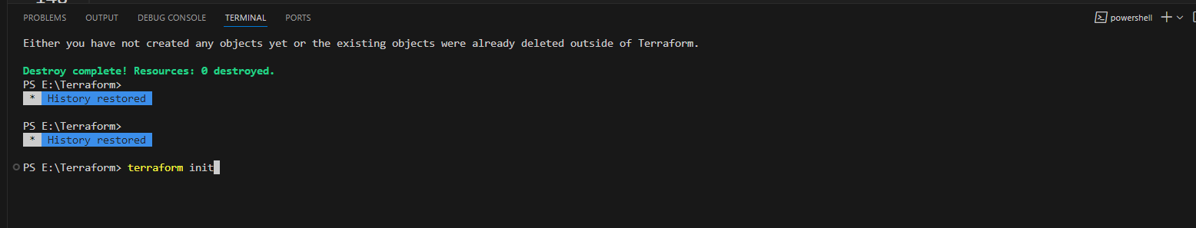
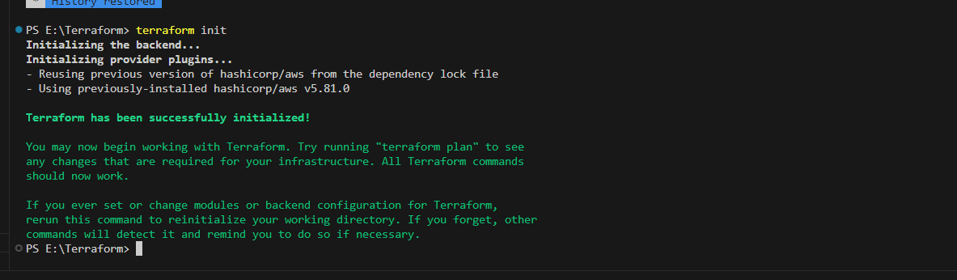
Terraform init : Initializes the environment
Initialize Terraform:
Ensures the backend configuration (for storing the state file) is correctly set up
This step initializes the working directory containing the Terraform configuration files.
It downloads the necessary provider plugins (e.g., AWS).

Slide 16

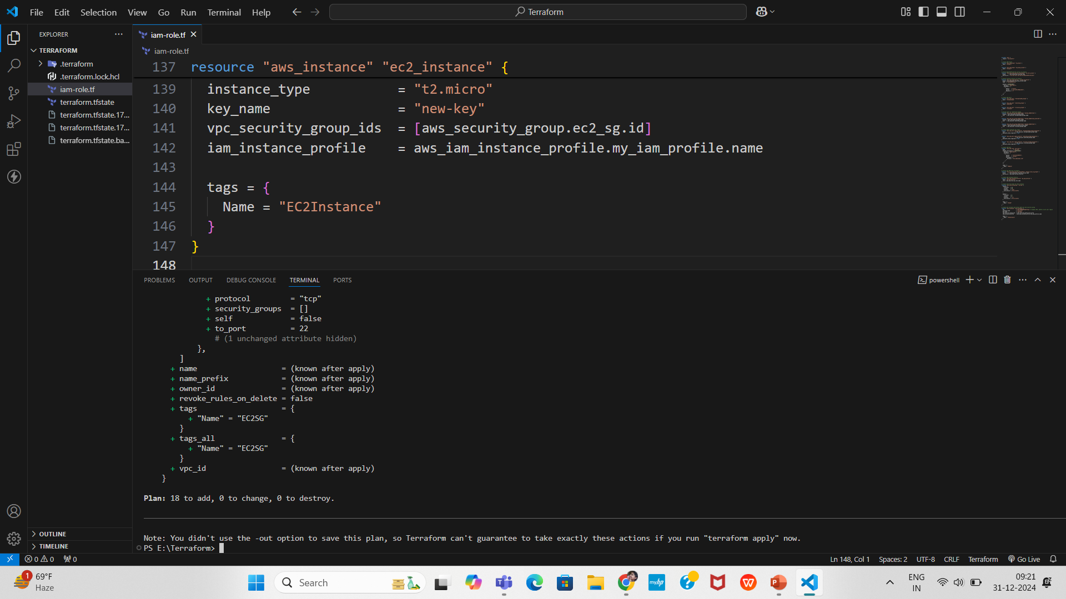
Terraform plan : Previews the changes.
Plan the Terraform Deployment :
Generates and displays an execution plan without making any changes to the infrastructure.
Shows what resources will be created, modified, or destroyed.
Helps to review the changes before applying them

Slide 17
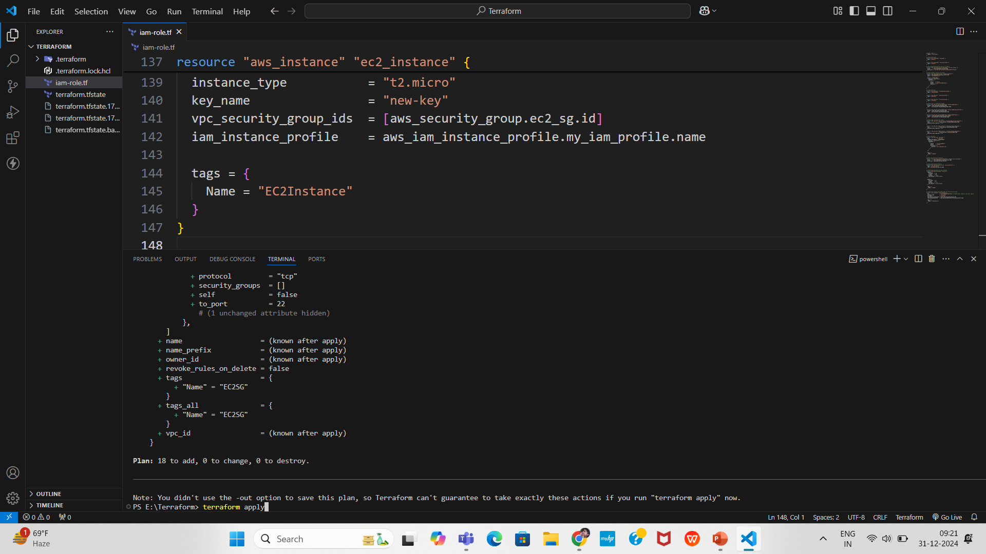
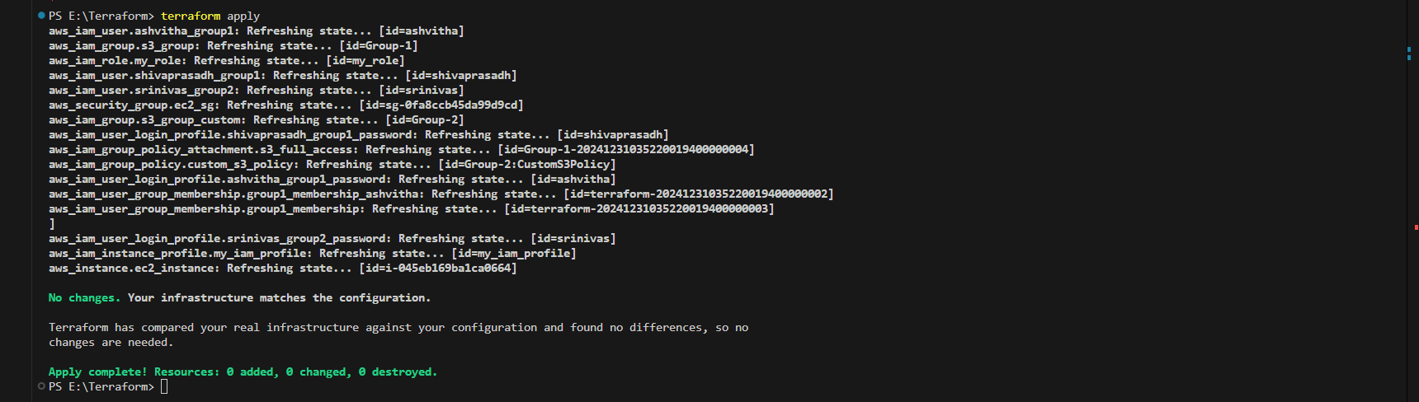
Terraform apply : Executes the changes.
Apply the Terraform Deployment :
Prompts for confirmation before making changes. Use the -auto-approve flag for automation.
Executes the changes proposed in the terraform plan step.
Applies the configuration to create, update, or delete the specified resources

Slide 18
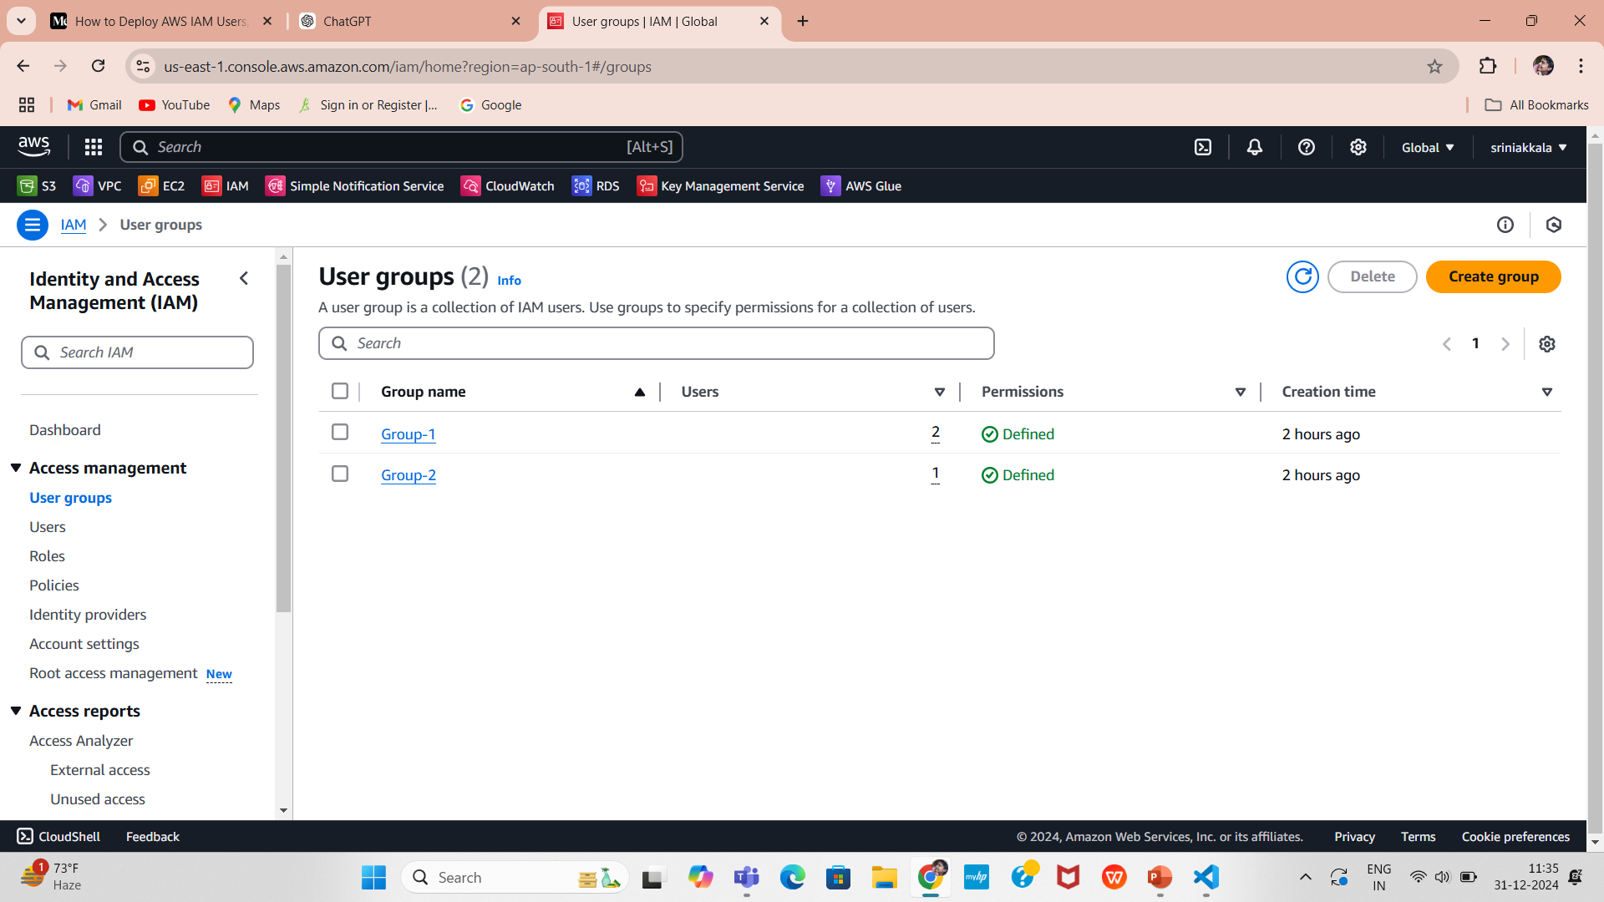
Verifying Outputs in the AWS Management Console
The following screenshots provide a step-by-step verification of the Terraform configurations deployed to the AWS environment. These steps validate the proper creation and configuration of resources:
IAM Groups and Policies:
Confirm the creation of IAM Groups (Group-1 and Group-2) in the IAM section.
Verify the attached policies, including AmazonS3FullAccess for Group-1 and the custom S3 policy for Group-2

Slide 19
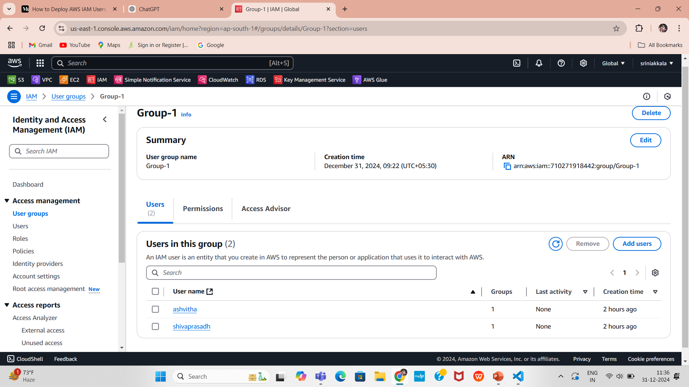
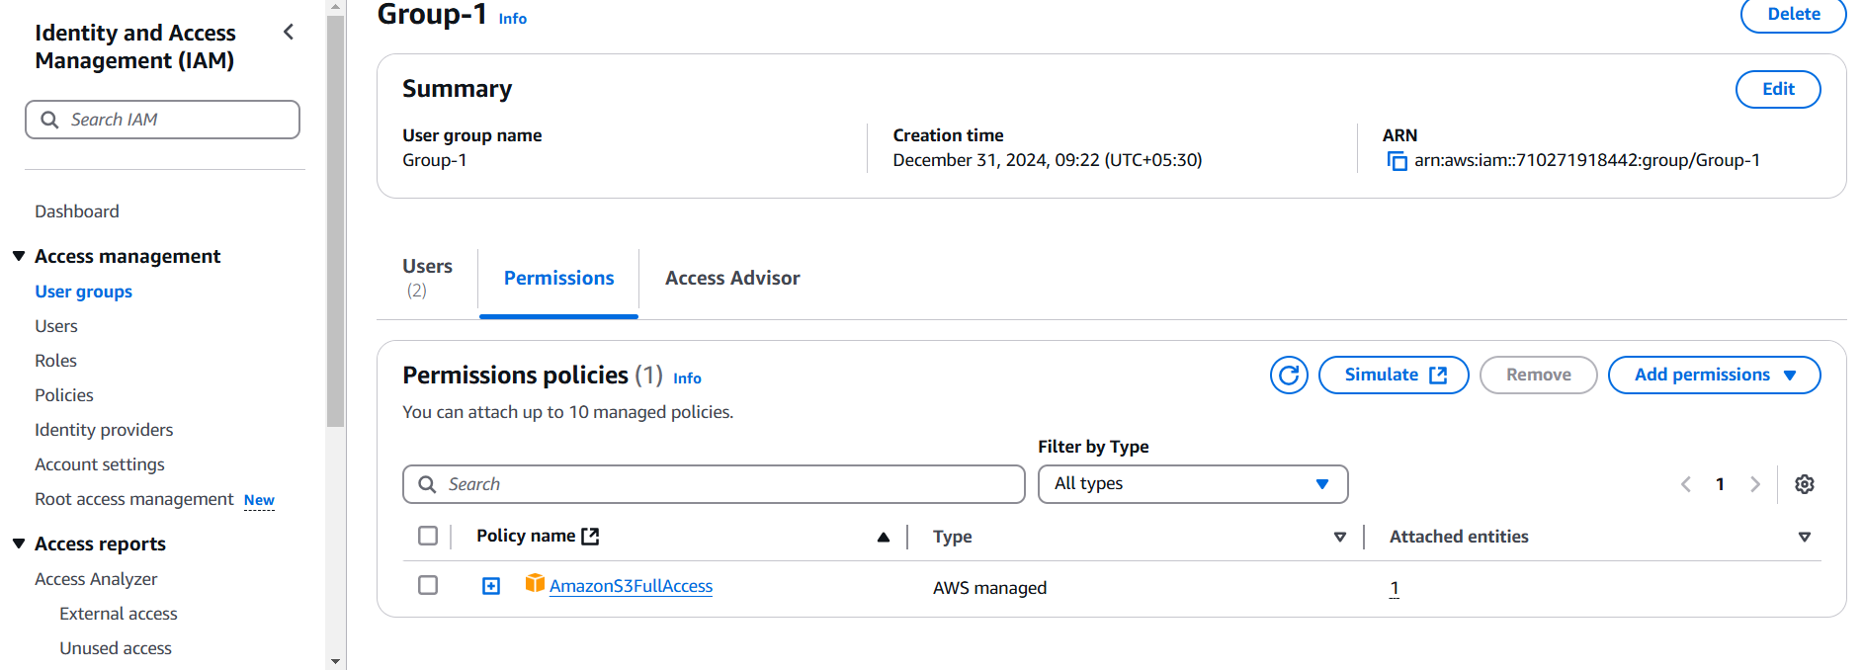
Group-1 Configurations:
Group-1 Users and attached permissions policies (AmazonS3FullAccess)
Ensure the users (shivaprasadh and ashvitha) are created and assigned to their respective groups.

Slide 20
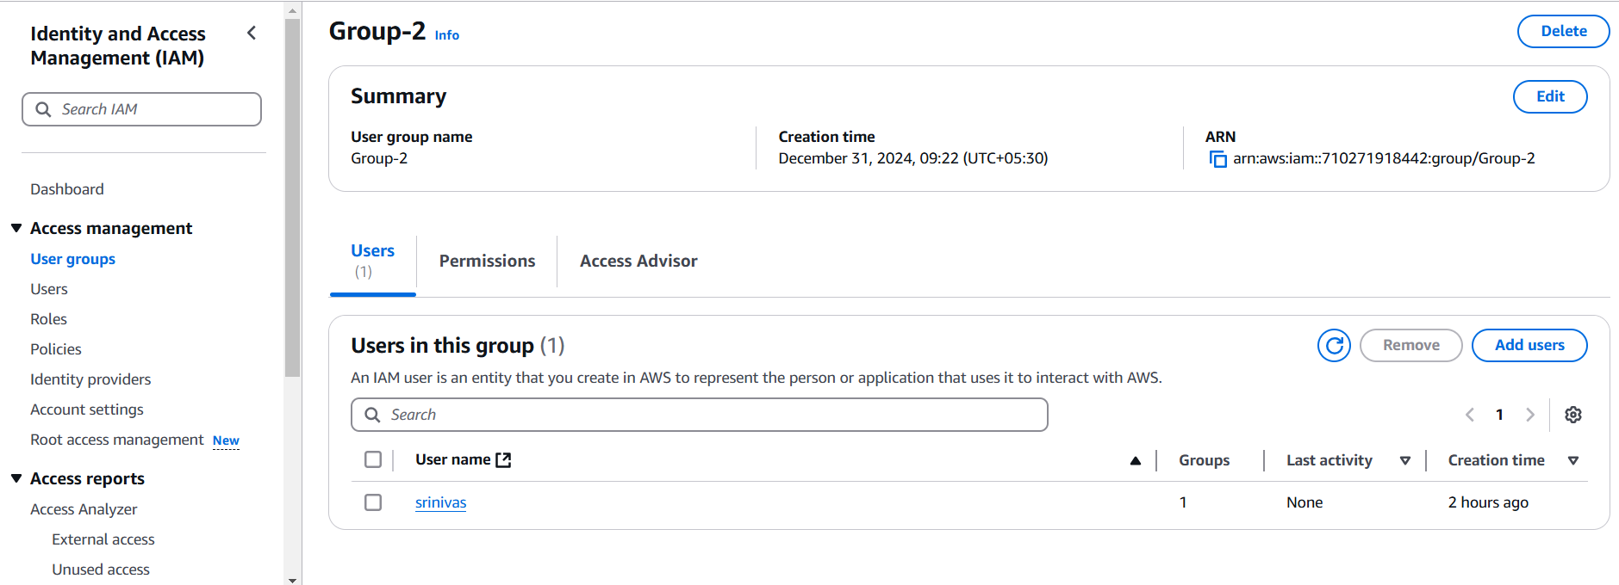
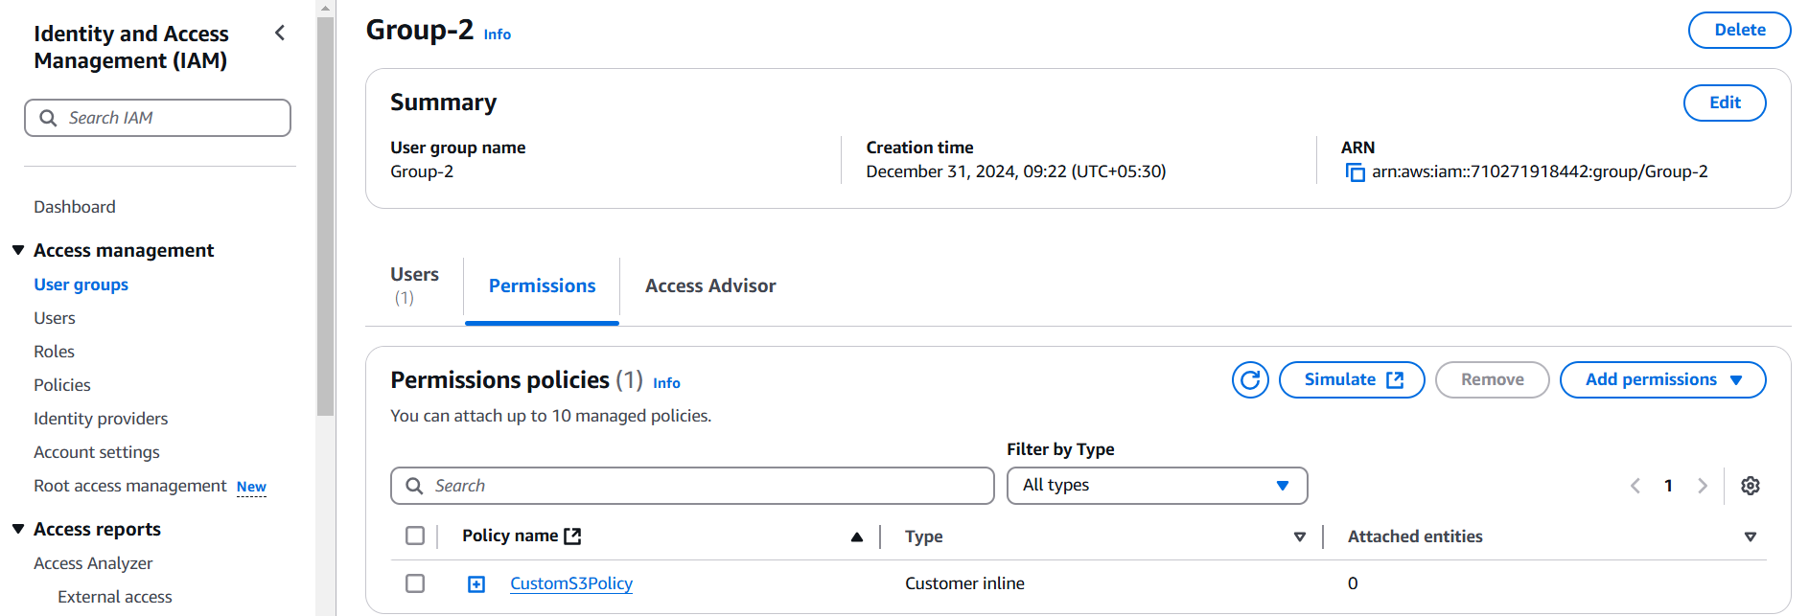
Group-2 Configurations:
Group-2 Users and attached inline policies
(S3-ListAllMyBuckets)
Ensure the user (srinivas) is created and assigned to their respective groups.

Slide 21
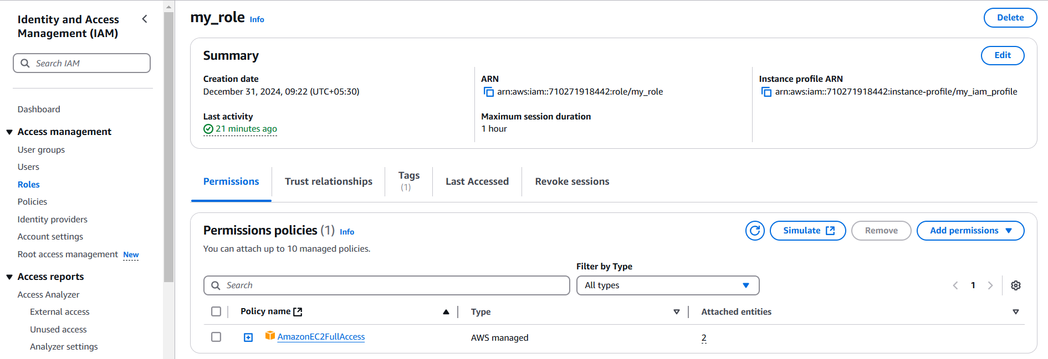
IAM Role and Instance Profile
Validate the creation of the IAM Role (my_role) and the associated instance profile (my_iam_profile).
Ensure the IAM Role's trust relationship is correctly defined for EC2 service.

Slide 22
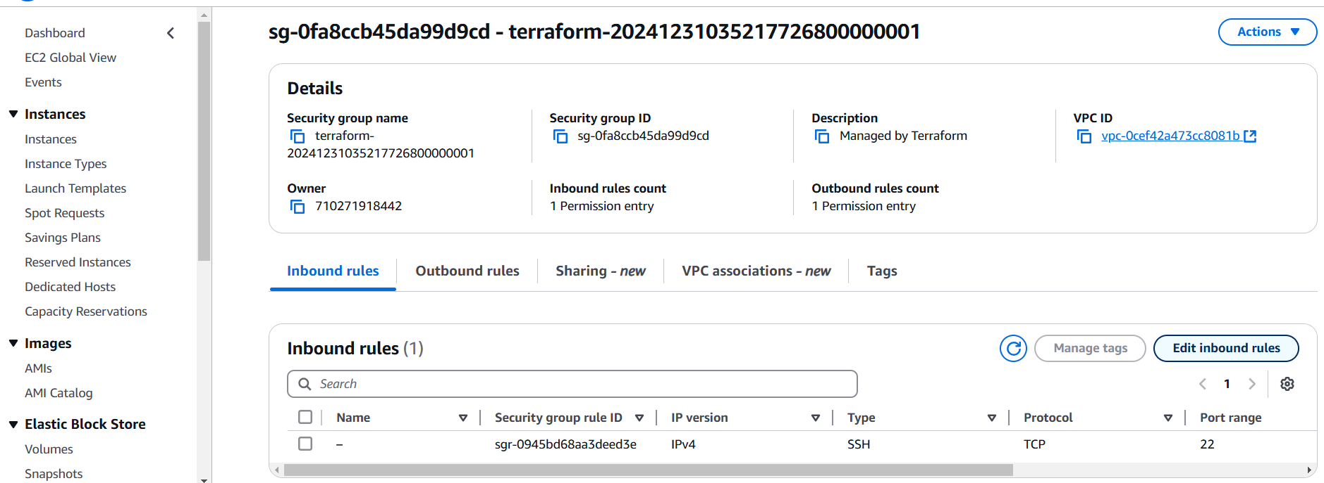
Security Group
Confirm the EC2 security group (EC2SG) allows SSH access (port 22) and has unrestricted outbound access.

Slide 23
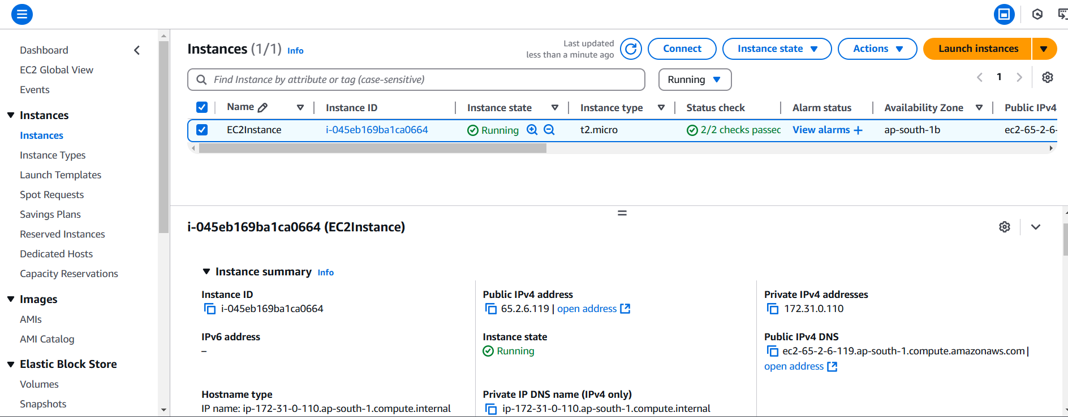
EC2 Instance
Ensure the EC2 instance is successfully launched and is in a running state.
Verify that the instance uses the specified AMI (ami-0fd05997b4dff7aac) and instance type (t2.micro).
Confirm that the EC2 instance is associated with the IAM Instance Profile (my_iam_profile), granting it the necessary permissions.
Check the instance's security group (EC2SG) to validate proper inbound and outbound rules, ensuring secure access.

Slide 24
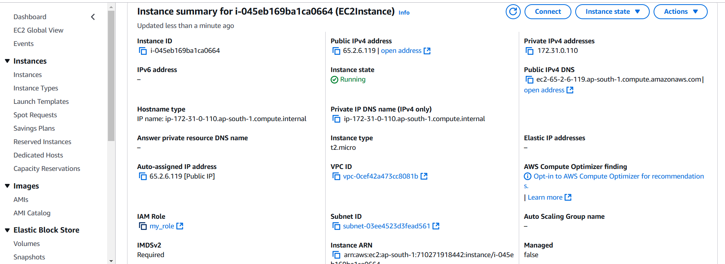
Instance Summary
All configurations have been successfully implemented and verified in the AWS Management Console. The IAM users, groups, roles, policies, and the EC2 instance are correctly set up as per the requirements. This confirms that the Terraform code executed accurately, ensuring compliance with the intended infrastructure setup and security standards.

Slide 25
Conclusion
This Terraform configuration successfully sets up a secure AWS environment with IAM roles, groups, and policies for user and EC2 instance management. It creates two IAM groups (Group-1 and Group-2), attaches predefined policies and custom permissions, and assigns users to these groups with specific login profiles. Additionally, an IAM role is created and linked to Group-2, allowing EC2 instances to assume it. The configuration also provisions an EC2 instance with appropriate security group settings and an IAM instance profile to control access. This setup ensures proper access management and security best practices, with clearly defined roles, policies, and resource access control for users and instances in the AWS environment.

